Slide 1
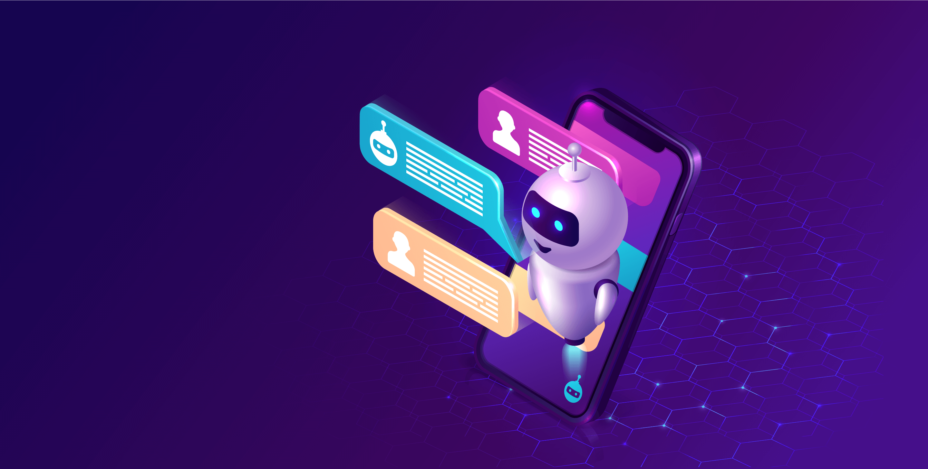
Proposed Solution: AI Chatbot for Enhanced User Experience
Group Members,
T.Naveen kumar,
R.Balaji,
R.Kavitha,
M.Kaviyarasu.
Faculty Mentor:
A.Ezhilmathi.,AP/CSE.

Slide 2
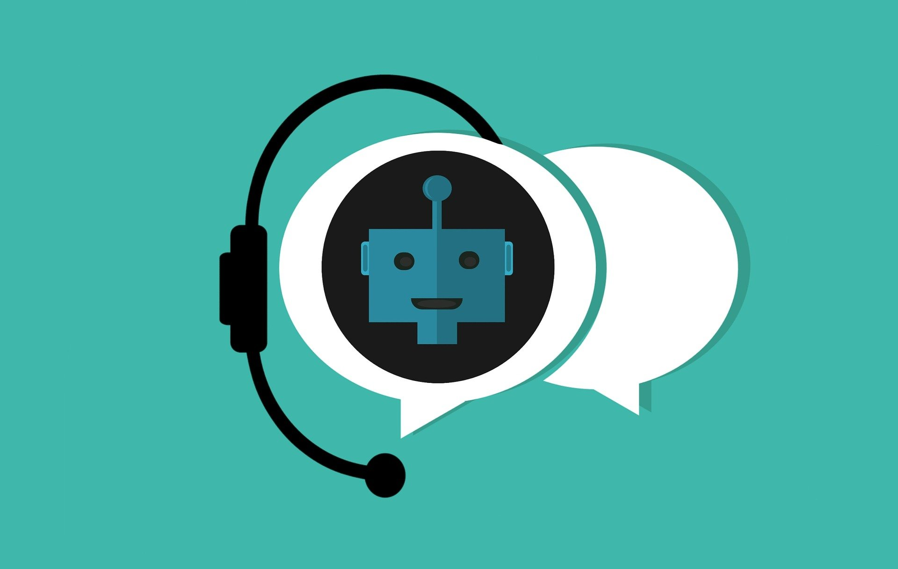
Project Overview
The objective of this project is to develop an AI Chatbot in Python that serves as a virtual concierge for websites and apps, providing immediate assistance to users and enhancing their overall experience.
Key Features and Functionality
1. Instant Responses : The Chatbot will be capable of providing instant responses to user queries, ensuring a timely and efficient customer service experience.
2. Natural Language Understanding : Leveraging advanced Natural Language Processing (NLP) and AI algorithms, the Chatbot will understand and interpret user queries accurately.
3. Conversational AI : The Chatbot will engage in natural, human-like conversations, guiding users through interactions with personalized responses.

Slide 3
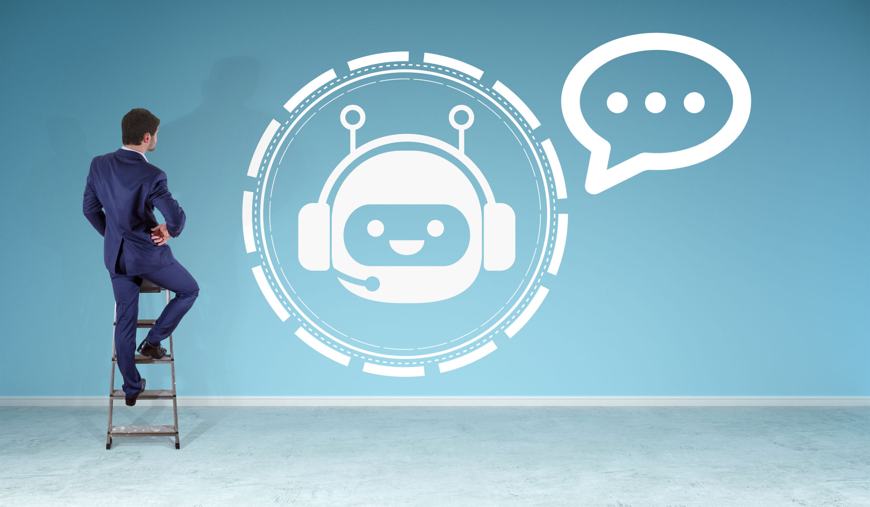
4. Multi-Turn Conversations: It will support multi-turn conversations, allowing users to ask follow-up questions and maintaining context throughout the conversation.
5. Intelligent Recommendations: The Chatbot will offer intelligent recommendations and suggestions based on user preferences and interactions.
6. 24/7 Availability: The Chatbot will be accessible 24/7, providing consistent and responsive assistance at any time.
7. User Privacy and Security: Robust security measures will be in place to protect user data and ensure compliance with data protection regulations.

Slide 4
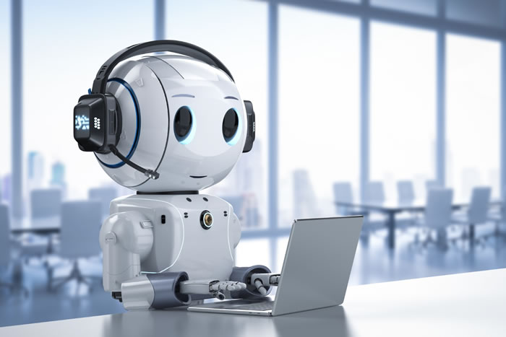
Technical Implementation
1. Technology Stack:
- Programming Language: Python
- NLP Libraries: NLTK, spaCy
- Deep Learning Framework: TensorFlow for advanced NLP capabilities
- Cloud Services: (e.g., AWS, Azure, or Google Cloud) for scalability and integration.
2. Chatbot Architecture:
- Rule-based and machine learning-based conversational models.
- Entity recognition, sentiment analysis, and intent classification.
3. Data Collection and Preparation:
- Collect data from various sources, such as FAQs, user interactions, and support records.
- Preprocess and annotate data for training NLP models.

Slide 5
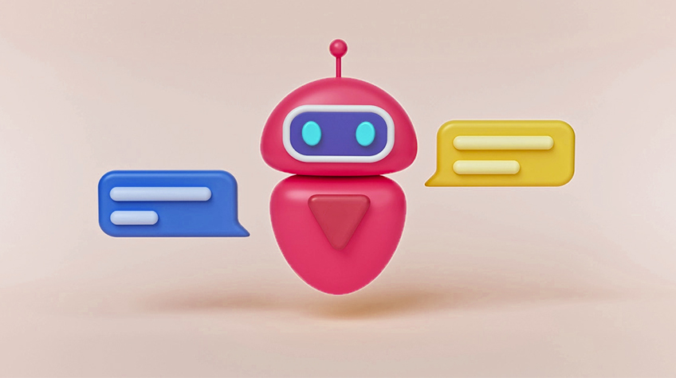
4. Training and Testing:
- Train the Chatbot using the prepared data and NLP models.
- Create a testing environment for evaluating its performance.
- Continuous improvement and optimization based on user feedback and interactions.
5. Integration:
- Integrate the Chatbot with websites and apps to provide a seamless user experience.
- Implement APIs for interaction with external systems or databases.
6. User Experience (UX) Design:
- Develop an intuitive user interface with user-friendly interactions.
- Personalize the Chatbot's responses and recommendations for each user.

Slide 6
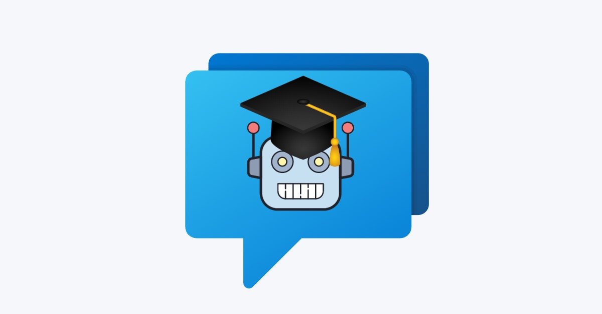
7. Security and Privacy :
- Implement robust security measures to protect user data.
- Ensure compliance with data protection regulations.
- Regularly update security protocols to mitigate risks.
8. Documentation and Training :
- Document the Chatbot's architecture, design, and usage guidelines.
- Provide training materials for users and administrators.
9. Testing and Quality Assurance :
- Rigorous testing, including functional, integration, and load testing.
- Prompt identification and resolution of issues and bugs.

Slide 7
10. Deployment:
- Deploy the Chatbot to production environments, websites, and apps.
- Monitor performance and user interactions, and implement version control for updates and maintenance.
11. User Feedback and Iteration:
- Collect user feedback and analyze it for continuous improvements.
- Iterate on the Chatbot to enhance its capabilities and accuracy based on user input.

Slide 8
Conclusion
The proposed solution for the AI Chatbot project envisions a sophisticated and innovative virtual concierge that will significantly enhance user experiences on websites and apps.
It will provide users with immediate assistance, personalized recommendations, and the convenience of 24/7 availability.
Leveraging advanced NLP and AI algorithms, the Chatbot aims to be a valuable addition to any platform, much like a knowledgeable hotel concierge.
This solution outlines the project's direction, features, and the technical approach to achieve these objectives. Detailed implementation, testing, and ongoing improvement will be carried out in subsequent project phases.

